Slide 1
P BLOCK ELEMENTS

Slide 2
15 GROUP ELEMENTS
Nitrogen (Nonmetal)
Phosphorus (Nonmetal)
Arsenic (Metalloid)
Antimony (Metalloid)
Bismuth (Metal)

Slide 3
Electronic Configuration: ns²np³
Atomic and Ionic Radii: Covalent and ionic radii increase in size down the group. From As to Bi increase in covalent radius is very small due to d and f orbitals.
Ionisation Enthalpy: Ionisation enthalpy decreases down the group due to gradual increase in atomic size. Because of stable half filled electronic configuration gp 15 has high IE than gr 14 elements.
Electronegativity: The electronegativity value, in general, decreases down the group with increasing atomic size.

Slide 4
Chemical Properties
Oxidation states: These elements show oxidation state of -3, +3 and +5. The stability of +5 oxidation state decreases down the group due to inert pair effect.
Nitrogen cannot exhibit valency more than 4 but other element can due to the absence of d-orbital in case of Nitrogen.

Slide 5
Anomalous properties of nitrogen
Nitrogen differs from the rest of the members of this group due to:
(1) its small size
(2) high electronegativity,
(3) high ionization enthalpy and
(4) non-availability of d orbitals.
Nitrogen has unique ability to form pπ -pπ multiple bonds with itself and with other elements having small size and high electronegativity (e.g., C, O). Heavier elements of this group do not form pπ -pπ bonds as their atomic orbitals are so large and diffuse that they cannot have effective overlapping.

Slide 6
Bond enthalpy of nitrogen is very high due to tripple bond in Nitrogen as compared to other elements.
nitrogen cannot form dπ –pπ bond due to the absence of d orbitals.
Reactivity towards hydrogen: EH₃
The stability of hydrides decreases from NH3 to BiH3
The reducing character of the hydrides increases down the group.
Basicity also decreases in the order NH3 > PH3 > AsH3 > SbH3 > BiH3.

Slide 7
Reactivity towards oxygen:these elements form two types of oxides: E2O3 and E2O5.
The oxide in the higher oxidation state of the element is more acidic than that of lower oxidation state.
Reactivity towards halogens:These elements react to form two series of halides: EX3 and EX5.
Nitrogen does not form pentahalide due to non-availability of the d orbitals in its valence shell.

Slide 8
All the trihalides of these elements except those of nitrogen are stable. In case of nitrogen, only NF3 is known to be stable.
Trihalides except BiF3 are predominantly covalent in nature.
PH3 has lower boiling point than NH3 because of absence of hydrogen bonding in PH3.
Pentahalides more covalent than trihalides. Since the metal ion with a high charge has more polarizing power, pentahalides are more covalent than trihalides.

Slide 9
Dinitrogen: In the laboratory, dinitrogen is prepared by treating an aqueous solution of ammonium chloride with sodium nitrite.
N2 can also be obtained by the thermal decomposition of ammonium dichromate.
Very pure nitrogen can be obtained by the thermal decomposition of sodium or barium azide.
Ba(N3)2→ Ba + 3N2

Slide 10

Dinitrogen is very less reactive at room temperature because of the high bond enthalpy of nitrogen–nitrogen tripple bond.
At higher temperatures, combines with some metals to form predominantly ionic nitrides and with non-metals, covalent nitrides.
It combines with hydrogen at about 773 K in the presence of a catalyst (Haber’s Process) to form ammonia.
Dinitrogen combines with dioxygen only at very high temperature (at about 2000 K) to form nitric oxide, NO.

Slide 11

Ammonia: Is formed by the decay of nitrogenous organic matter e.g., urea.
On a small scale ammonia is obtained from ammonium salts
On a large scale, ammonia is manufactured by Haber’s process.

Slide 12
According to Le Chatelier’s principle, high pressure favours the formation of ammonia. The reaction takes place at a temperature of 700 K and a t a pressure 200atm. Iron oxide is used as a catalyst in the presence of K2O or Al2O3 which increases the rate of attainment of equilibrium.

Slide 13
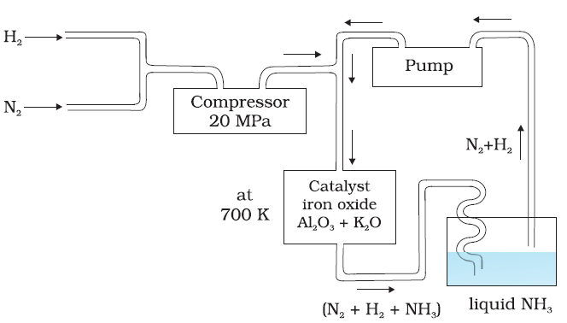
Flow diagram of Haber’s process

Slide 14
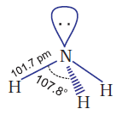
Properties
Ammonia has high melting and boiling point due to presence of hydrogen bonding.
Ammonia molecule has trigonal pyramid.
It has three bond pairs and one
lone pair of electrons.
Ammonia gas is highly soluble in
water. Its aqueous solution is weakly basic due to the formation of OH– ions.

Slide 15
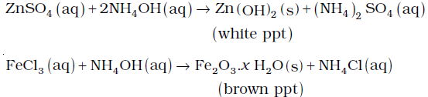
It forms ammonium salts with acids, e.g., NH4Cl, (NH4)2 SO4, etc. As a weak base, it precipitates the hydroxides of many metals from their salt solutions.
Because of the presence of lone pair it act as Lewis base.
It donates the electron pair and forms linkage with metal ions and the formation of such complex compounds finds applications in detection of metal ions

Slide 16
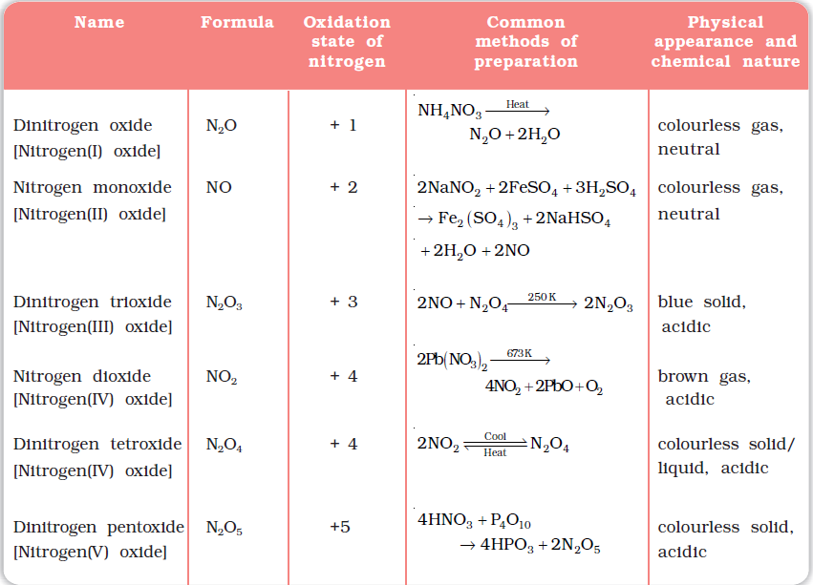
Oxides of Nitrogen

Slide 17
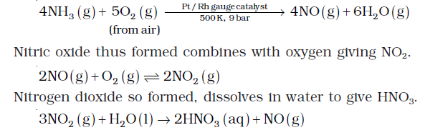
Nitric Acid
In the laboratory, nitric acid is prepared by heating KNO3 or NaNO3 and concentrated H2SO4.
On a large scale it is prepared mainly by Ostwald’s process.

Slide 18
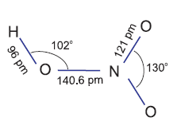
Further concentration to 98% can be achieved by dehydration with concentrated H2SO4.
Properties:
In aqueous solution, nitric acid behaves as a strong acid giving
hydronium and nitrate
ions.
Concentrated nitric acid is
a strong oxidising agent
and attacks most metals except noble metals
such as gold and platinum.

Slide 19


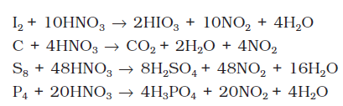
Cr, Al do not dissolve in concentrated nitric acid because of the formation of a passive film of oxide on the surface.

Slide 20

Brown Ring Test:brown ring test for nitrates depends on the ability of Fe2+ to reduce nitrates to nitric oxide, which reacts with Fe2+ to form a brown coloured complex.

Slide 21

Phosphorus —Allotropic Forms
White phosphorus:
translucent white waxy solid
Poisonous
glows in dark
insoluble in water but soluble in carbon disulphide
It dissolves in boiling NaOH solution giving PH3.

Slide 22
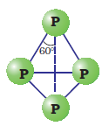
It is more reactive than because of angular strain in the P4 molecule where the angles are only 60°.
It readily catches fire in air
to give dense white fumes
of P4O10.
Red phosphorus: It is obtained by heating white phosphorus at 573K.
When red phosphorus is heated under high pressure, a series of phases of black phosphorus is formed.

Slide 23
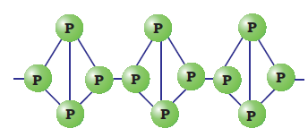
Nonpoisonous
insoluble in water as well as in carbon disulphide.
does not glow in the dark
is much less reactive than white phosphorus.

Slide 24
Black phosphorus: It has two forms α-black
phosphorus and ẞ-black phosphorus.
α -Black phosphorus is formed when red phosphorus is heated in a sealed tube at 803K. It does not oxidise in air. It has opaque monoclinic or rhombohedral crystals.
ẞ-Black phosphorus is prepared by heating white phosphorus at 473 K under high pressure.

Slide 25


Phosphine
Preparation: Phosphine is prepared by the reaction of calcium phosphide with water or dilute HCl.
In the laboratory,

Slide 26

Properties:
It is a colourless gas with rotten fish smell and is highly poisonous.
It is slightly soluble in water.
When absorbed in copper sulphate or mercuric chloride solution, the corresponding phosphides are obtained.
Phosphine is weakly basic

Slide 27
Phosphorus Halides: PX5 and PX3:
Phosphorus Trichloride:
Preparation:
It is obtained by passing dry chlorine over heated white phosphorus.
P4 + 6Cl2 → 4PCl3
It is also obtained by the action of thionyl chloride with whitephosphorus.
P4 + 8SOCl2 → 4PCl3 + 4SO2+ 2S2Cl2

Slide 28
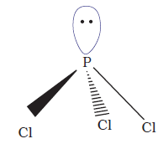
Properties:
hydrolyses in the presence of moisture.
It reacts with organic compounds containing –OH group such as CH3COOH, C2H5OH.

Slide 29

Phosphorus Pentachloride:
Preparation:
Phosphorus pentachloride is prepared by the reaction of white phosphorus with excess of dry chlorine.
It can also be prepared by the action of SO2Cl2 on phosphorus.

Slide 30



Properties: PCl5 hydrolyses to POCl3 and finally gets converted to phosphoric acid.
It decomposes on stronger heating.
It reacts with organic compounds containing –OH group converting them to chloro derivative.
metals on heating with PCl5 give corresponding chlorides.

Slide 31
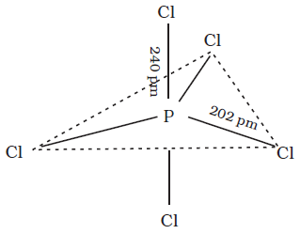
Structure of PCL5

Slide 32
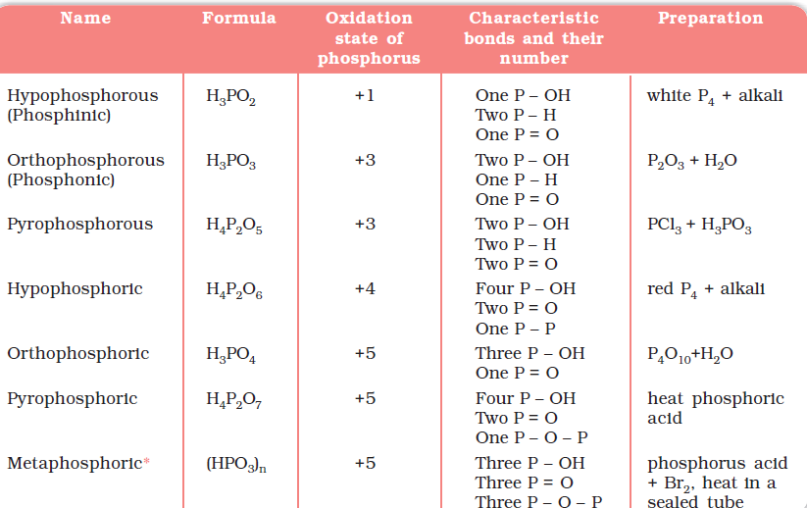
Oxoacids of Phosphorus

Slide 33
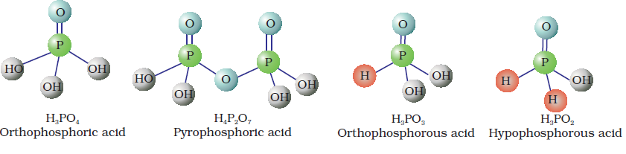
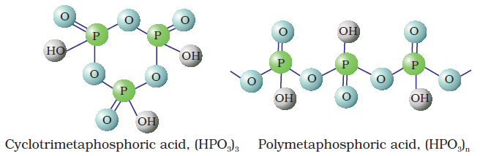
Structures of oxoacids of P

Slide 34
orthophophorous acid (or phosphorous acid) on heating disproportionates to give orthophosphoric acid (or phosphoric acid) and phosphine.
hypophosphorous acid is a good reducing agent as it contains two P–H bonds and reduces AgNO3 to metallic silver.
H3PO3 and H3PO4 are dibasic and tribasic.

Slide 35
Group 16 Elements
Oxygen
sulphur
selenium
tellurium
polonium

Slide 36
Electronic Configuration: ns2 np4
Atomic and Ionic Radii:
Ionisation Enthalpy: elements of group 16 has have lower ionisation enthalpy values than Group15 in the corresponding periods due to stable half filled electronic configuration of group 15 elements.
Electron Gain Enthalpy: oxygen atom has less negative electron gain enthalpy than sulphur due to very small size of oxygen.
Electronegativity: Within the group, electro- negativity decreases with increase in atomic number.

Slide 37
Chemical properties:
Oxidation states and trends in chemical reactivity: The stability of -2 oxidation state decreases down the group. In the case of OF2 where its oxidation state is + 2. Other elements of the group exhibit + 2, + 4, + 6 oxidation states but + 4 and + 6 are more common.
stability of + 4 oxidation state increases (inert pair effect).

Slide 38
Anomalous behaviour of oxygen: It is due to its small size and high electronegativity and absence of d orbitals.
Reactivity with hydrogen:Group 16 form hydrides of the type H2E
Their acidic character increases from H2O to H2Te. It is due to decrease in bond enthalpy for the dissociation of H–E bond down the group.
the thermal stability of hydrides also decreases from H2O to H2Po.

Slide 39
reducing property increases from H2S to H2Te.
Reactivity with oxygen:All these elements form oxides of the EO2 and EO3. Both types of oxides are acidic in nature.
Reactivity towards the halogens: Group 16 form a large number of halides of the type, EX6, EX4 and EX2.
Amongst hexahalides, hexafluorides are the only stable halides.
tetrafluorides, have sp3d hybridisation and thus, have trigonal bipyramidal structures in which one of the equatorial positions is occupied by a lone pair of electrons. This geometry is also regarded as see-saw geometry.

Slide 40


Dioxygen:
Preparation:
By heating oxygen containing salts such as chlorates, nitrates and permanganates.
By the thermal decomposition of the oxides of metals.
Hydrogen peroxide is readily decomposed into water and dioxygen

Slide 41
Electrolysis of water leads to the release of hydrogen at the cathode and oxygen at the anode.
Properties: Dioxygen directly reacts with nearly all metals and non-metals except some metals. However, to initiate the reaction, some external heating is required as bond dissociation enthalpy of oxgyen-oxygen double bond is high.

Slide 42
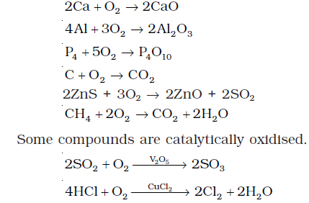
Some of the reactions of dioxygen with metals, non-metals and other compounds are given below:

Slide 43

Simple Oxides: A binary compound of oxygen with another element is called oxide.
Simple oxides can be acidic, basic or amphoteric character.
An oxide that combines with water to give an acid is termed acidic oxide (e.g., SO2, Cl2O7, CO2, N2O5 ).
non-metal oxides are acidic but oxides of some metals in high oxidation state also have acidic character (e.g., Mn2O7, CrO3, V2O5).
The oxides which give a base with water are known as basic oxides (e.g., Na2O, CaO, BaO).

Slide 44

Some metallic oxides show characteristics of both acidic as well as basic oxides. Such oxides are known as amphoteric oxides.
neutral oxides: Examples of neutral oxides are CO, NO and N2O.

Slide 45
Ozone: Ozone is an allotropic form of oxygen. It is very reactive. ozone layer protects the earth’s surface from an excessive concentration of ultraviolet (UV) radiations.
Preparation: When a slow dry stream of oxygen is passed through a electrical discharge, conversion of oxygen to ozone (10%) occurs. The product is known as ozonised oxygen.

Slide 46

Properties:
Experiments have shown that nitrogen oxides (particularly nitric oxide) combine very rapidly with ozone and there is, thus, the possibility that nitrogen oxides emitted from the exhaust systems of supersonic jet aeroplanes might be slowly depleting the concentration of the ozone layer in the upper atmosphere.

Slide 47
Sulphur — Allotropic Forms:
Rhombic sulphur (a-sulphur):
yellow in colour
It is insoluble in water but dissolves to some extent in benzene, alcohol and ether.
It is soluble in CS2.
Monoclinic sulphur (b-sulphur):
It is stable above 369 K and transforms into a-sulphur below it. This temperature is called transition temperature.

Slide 48
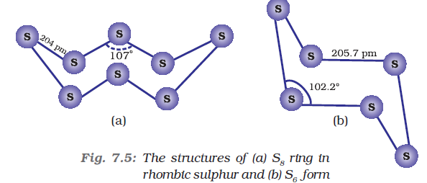
Both rhombic and monoclinic sulphur have S8 molecules.
The S8 ring in both the forms is puckered and has a crown shape.

Slide 49
Sulphur Dioxide: Sulphur dioxide is formed together with a little (6-8%) sulphur trioxide when sulphur is burnt in air or oxygen:
S(s) + O2(g) → SO2 (g)
Industrially, it is produced as a by-product of the roasting of sulphide ores.
Properties: Sulphur dioxide, when passed through water, forms a solution of sulphurous acid. SO2 (g) + H2O (l) →H2SO3

Slide 50


It reacts readily with sodium hydroxide solution, forming sodium sulphite, which then reacts with more sulphur dioxide to form sodium hydrogen sulphite.
Sulphur dioxide reacts with chlorine in the presence of charcoal to give sulphuryl chloride, SO2Cl2. It is oxidised to sulphur trioxide by oxygen in the presence of vanadium(V) oxide catalyst.

Slide 51


When moist, sulphur dioxide behaves as a reducing agent. For example, it converts iron(III) ions to iron(II) ions and decolourises acidified potassium permanganate(VII) solution.

Slide 52
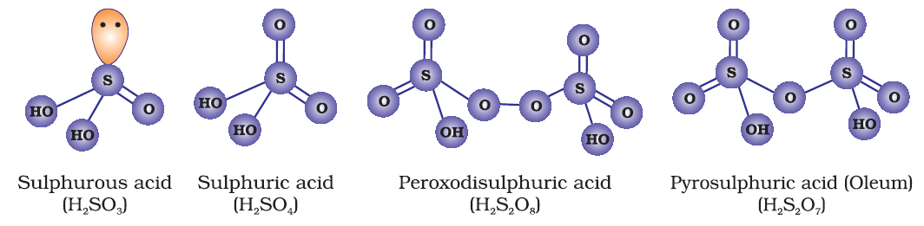
Oxoacids of Sulphur: Sulphur forms a number of oxoacids such as H2SO3, H2S2O3, H2S2O4, H2S2O5, H2SxO6 (x = 2 to 5), H2SO4, H2S2O7, H2SO5, H2S2O8 .

Slide 53
Sulphuric Acid: Sulphuric acid is manufactured by the Contact Process which involves three steps:
(i) burning of sulphur or sulphide ores in air to generate SO2.
(ii) conversion of SO2 to SO3 by the reaction with oxygen in the presence of a catalyst (V2O5), and
(iii) absorption of SO3 in H2SO4 to give Oleum (H2S2O7).
The key step in the manufacture of H2SO4 is the catalytic oxidation of SO2 with O2 to give SO3 in the presence of V2O5 (catalyst).

Slide 54
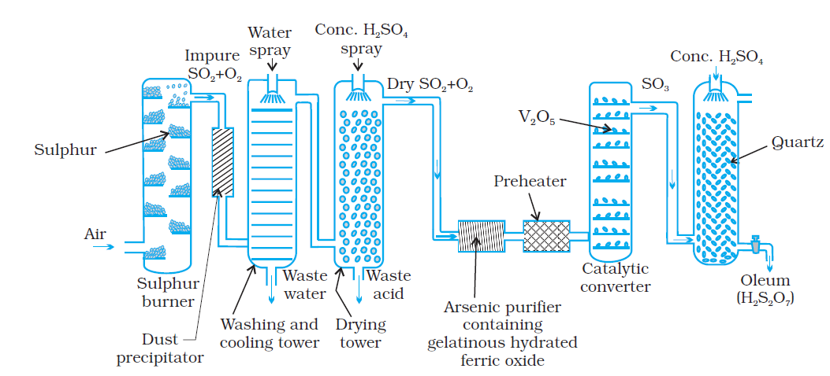
Dilution of oleum with water gives H2SO4 of the desired concentration.

Slide 55

Properties: It dissolves in water with the evolution of a large quantity of heat.
The chemical reactions of sulphuric acid are as a result of the following characteristics:
low volatility
(b) strong acidic character
(c) strong affinity for water and
(d) ability to act as an oxidising agent.
It ionises in two steps:

Slide 56
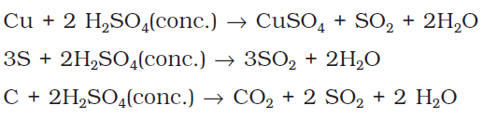
Concentrated sulphuric acid is a strong dehydrating agent.
Hot concentrated sulphuric acid is a moderately strong oxidising agent.

Slide 57
Group 17 Elements
Fluorine,
chlorine,
bromine,
iodine and
Astatine
These are collectively known as the halogens

Slide 58
Electronic Configuration: ns2 np5
Atomic and Ionic Radii: The halogens have the smallest atomic radii in their respective periods due to maximum effective nuclear charge. It increases down the group.
Ionisation Enthalpy: they have very high ionisation enthalpy due to very less tendency to give electron.
Electron Gain Enthalpy: Halogens have maximum negative electron gain enthalpy in the corresponding periods. This is due to the fact that the atoms of these elements have only one electron less than stable noble gas configurations.

Slide 59
Electron gain enthalpy of F is very less as compared to Chlorine due its very small size. As a result, there are strong interelectronic repulsions in the relatively small 2p orbitals of fluorine and thus, the incoming electron does not experience much attraction.
Electronegativity: They have very high electronegativity. The electronegativity decreases down the group.

Slide 60
All halogens are coloured. This is due to absorption of radiations in visible region which results in the excitation of outer electrons to higher energy level. By absorbing different quanta of radiation, they display different colours.
Bond dissociation enthalpy decreases down the group bur F-F has exceptionally low bond dissociation enthalpy due to large electron-electron repulsion among the lone pairs.

Slide 61
Chemical Properties: All the halogens exhibit –1 oxidation state. However, chlorine, bromine and iodine exhibit + 1, + 3, + 5 and + 7 oxidation states also.
The fluorine atom has no d orbitals in its valence shell and therefore cannot expand its octet. Being the most electronegative, it exhibits only –1 oxidation state.
The ready acceptance of an electron is the reason for the strong oxidising nature of halogens. F2 is the strongest oxidising halogen and it oxidises other halide ions in solution or even in the solid phase.

Slide 62
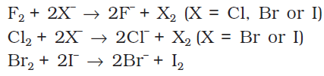
Anomalous behaviour of fluorine: The anomalous behaviour of fluorine is due to its small size, highest electronegativity, low F-F bond dissociation enthalpy, and non availability of d orbitals in valence shell.
Reactivity towards hydrogen:They all react with hydrogen to give hydrogen halides but affinity for hydrogen decreases from fluorine to iodine.

Slide 63
The acidic strength of these acids varies in the order:
HF < HCl < HBr < HI.
The stability of these halides decreases down the group due to decrease in bond (H–X) dissociation enthalpy in the order: H–F > H–Cl > H–Br > H–I.

Slide 64
Reactivity towards oxygen:Fluorine forms two oxides OF2 and O2F2. Both are strong fluorinating agents. O2F2 oxidises plutonium to PuF6 and the reaction is used in removing plutonium as PuF6 from spent nuclear fuel.
Reactivity towards metals:Halogens react with metals to form metal halides. the halides in higher oxidation state will be more covalent than the one in lower oxidation state. For example, SnCl4, PbCl4, SbCl5 and UF6 are more covalent than SnCl2, PbCl2, SbCl3 and UF4 respectively.

Slide 65
Reactivity of halogens towards other halogens: Halogens combine amongst themselves to form a number of compounds known as inter halogen compounds.

Slide 66
Chlorine:
Preparation: By heating manganese dioxide with concentrated hydrochloric acid.
By the action of HCl on potassium permanganate.
Manufacture of chlorine:
Deacon’s process:
Electrolytic process:

Slide 67


Properties:
Chlorine reacts with a number of metals and non-metals to form chlorides.
It has great affinity for hydrogen.

Slide 68

With excess ammonia, chlorine gives nitrogen and ammonium chloride whereas with excess chlorine, nitrogen trichloride (explosive) is formed.
With dry slaked lime it gives bleachin powder.
2Ca(OH)2 + 2Cl2 →Ca(OCl)2 + CaCl2 + 2H2O

Slide 69
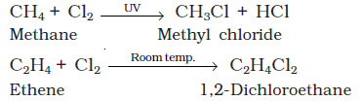
Chlorine reacts with hydrocarbons and gives substitution products with saturated hydrocarbons and addition products with unsaturated hydrocarbons.
Chlorine water on standing loses its yellow colour due to the formation of HCl and HOCl. Hypochlorous acid (HOCl) so formed, gives nascent oxygen which is responsible for oxidising and bleaching properties of chlorine.

Slide 70
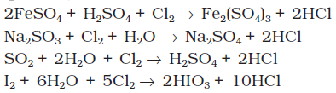


Slide 71

Hydrogen Chloride:
Preparation: it is prepared by heating sodium chloride with concentrated sulphuric acid.
Properties: It is extremely soluble in water and ionises as follows:
It reacts with NH3 and gives white fumes of NH4Cl.
NH3 + HCl → NH4Cl
3: 1 ratio of HCl and HNO3 is called as Aqua Regia and is used to dissolve noble metals

Slide 72

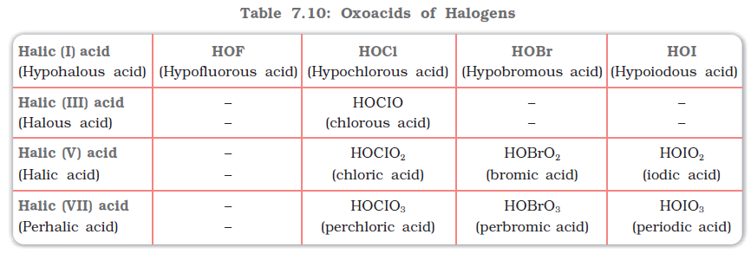
Hydrochloric acid decomposes salts of weaker acids
Oxoacids of Halogens: Due to high electronegativity and small size, fluorine forms only one oxoacid, HOF known as fluoric (I) acid or hypofluorous acid.

Slide 73
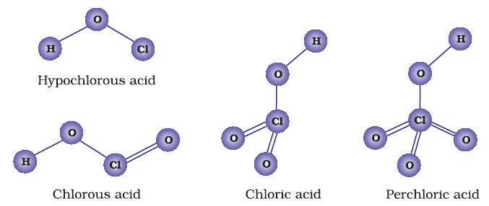

Slide 74
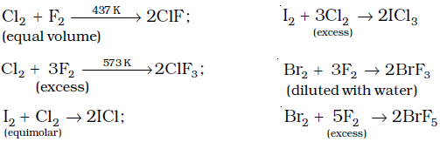
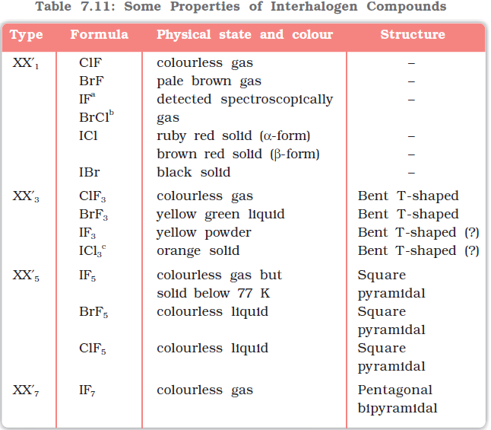
Preparation:

Slide 75

interhalogen compounds are more reactive than halogens (except fluorine). This is because X–X¢ bond in interhalogens is weaker than X–X bond in halogens except F–F bond.

Slide 76
Group 18 Elements
helium,
neon,
argon,
krypton,
xenon
radon.

Slide 77
Electronic Configuration: ns2np6 except helium which has 1s2
Ionisation Enthalpy: Due to stable electronic configuration these gases exhibit very high ionisation enthalpy.
Atomic Radii: Atomic radii increase down the group with increase in atomic number.
Electron Gain Enthalpy: They have large positive values of electron gain enthalpy due to stable electronic configuration.
They have very low melting and boiling points because the only type of interatomic interaction in these elements is weak dispersion forces.

Slide 78
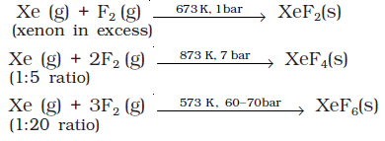
Chemical Properties: Noble gases are least reactive due to following reasons:
completely filled ns2np6 electronic configuration in their valence shell.
high ionization enthalpy and more positive electron gain enthalpy.
Xe⁺PtF6– is the first compound of noble gases.
Xenon-fluorine compounds:

Slide 79

XeF6 can also be prepared by the interaction of XeF4 and O2F2 at 143K.
Xenon-oxygen compounds: Hydrolysis of XeF4 and XeF6 with water gives Xe03.
Partial hydrolysis of XeF6 gives oxyfluorides, XeOF4 and XeO2F2.

Slide 80
